Slide 1
463.4 Crypto Constructs
Computer Security II
CS463/ECE424
University of Illinois

Slide 2
Outline
Crypto Constructs
Homomorphic encryption
Searchable encryption
Oblivious RAM
Private Set Intersection
Discussion

Slide 3
Background: Landscape
Symmetric key cryptography
Same key is used to encrypt and decrypt
Block ciphers, stream ciphers, modes of operations
Pseudorandom objects
Collision-resistant hash functions
Pseudorandom generators (PRGs)
Public key cryptography
Public key for encryption, private key for decryption
E.g., RSA

Slide 4
Background: Threat Model
Ciphertext-only attacks
Known-plaintext attacks
Chosen-plaintext attacks
Chosen-ciphertext attacks
Indistinguishability under Chosen Plaintext Attack
(IND-CPA)
Adversary can’t distinguish pairs of ciphertexts with respect to their plaintexts
Nondeterministic encryption scheme (E_{K}(m) is really E_{K}(m, r) for some random r)
Notes:
Ciphertext-only attacks: attacker knows ciphertexts, tries to decrypt them, or recover the key.
Known-plaintext attacks: attacker has a set of plaintext – ciphertext pairs, tries to recover the key, or decrypt *some other* ciphertext.
Chosen-plaintext attacks: attacker has is able to chose a plaintext and obtain the corresponding ciphertext (encrypted under an unknown key).
Chosen-ciphertext attacks: attacker can obtain the decryption of any ciphertext (under an unknown key).
IND-CPA: attacker can’t distinguish two ciphertexts with respect to their plaintexts with better than a negligible advantage over random guessing.
A necessary property to achieve CPA security is that the encryption scheme be nondeterministic (i.e., able to produce randomized ciphertexts). This is because the game in the definition of IND-CPA assumes the adversary is able to encrypt arbitrary messages.

Slide 5
463.4.1 Crypto Constructs: Homomorphic Encryption

Slide 6


What if we could…
Encrypt data
Send it to the cloud
Ask the cloud to perform operations
Compute, search, sort
Keeping data encrypted throughout the operation
Client
Cloud
E(x), f
x
f*
E(f(x))
f*(E(x)) = E(f(x))
Notes:
We would like to outsource computation or search to a cloud in such a way that the data stays encrypted throughout the protocol.
We don’t want to have to send data back and forth to decrypt / re-encrypt it.
We envision sending our data x to the cloud encrypted, along with a cleartext description of the operation we would like to perform on it, i.e., some function f.
The cloud would then perform an operation f* on the encrypted data in such a way that it could return a valid encryption of f(x).

Slide 7
Privacy Homomorphisms
[RAD78] Originally idea introduced by Rivest, Adleman, and Dertouzos
Proposed several privacy homomorphisms, but none of them were secure against chosen-plaintext attacks
x
y
E(x)
E(y)
□
○
x□y
E(x)○E(y)
Privacy homomorphism: Operators (□, ○) such that E(x)○E(y) = E(x□y)

Slide 8
Homomorphic Encryption
Fully Homomorphic Encryption (FHE)
Two operations: e.g., addition and multiplication
E(x (y + z)) = E(x) ◦ (E(y) □ E(z))
[Gentry09] First scheme
Not efficient
Partially Homomorphic Encryption (PHE)
Only one operation: e.g., only multiplication
E(x y) = E(x) ◦ E(y)
Many public-key cryptosystems are partially homomorphic, e.g., RSA - Fairly efficient
Notes:
FHE: addition and multiplication is universal (gives XOR and AND in mod 2, which can be used to get OR and NOT).
Craig Gentry PhD thesis [Gentry09] was the first fully homomorphic scheme. Although performance has been improving significantly, FHE is still not practical.
PHE: only one operation supported. Many public-key cryptosystems such as RSA have some homomorphic properties.
PHE are as efficient as the underlying cryptosystem.

Slide 9


Plain RSA
Setup:
p and q large primes, N = pq, φ =(p-1)(q-1),
Take e coprime with φ, and calculate d = e⁻¹ mod φ,
K’ = (N, d) is the private key
Alice
K ← (N, e)
Bob
Message m
c ← m^{e} mod N
Decryption
m = c^{d} mod N
[RSA76]

Slide 10
RSA
Setup:
p and q large primes, N = pq, φ =(p-1)(q-1),
Take e coprime with φ,
d = e⁻¹ mod φ, K’ = (N, d)
Alice
Bob
K ← (N, e)
Messages m₁, m₂
c₁ ← m₁e mod N, c₂ ← m₂e mod N
c ← c₁∙c₂ mod N
m₁∙m₂ ← c^{d} mod N
Plain RSA is a privacy homomorphism with respect to multiplication: E_{K}(xy) = E_{K}(x)∙E_{K}(y).
But it does not provide ciphertext indistinguishability (i.e., encryption is not randomized)
Notes:
Plain RSA is homomorphic with respect to multiplication: multiplying two ciphertexts yields a valid encryption of the product of the underlying plaintexts.
In practice, RSA is not used for its multiplicative homomorphism because encryption is not randomized (it is not IND-CPA secure).

Slide 11
Applications of PHE
e-Voting
Protect the anonymity of the voters
Digital cash
Ensure anonymity
Mix networks
Re-randomization of ciphertexts
Private Matching / Private Set Intersection
Search for members of a terrorism watch list in an air flight passenger list
Notes:
Some applications of Partially Homomorphic Encryption (PHE). In e-Voting system, PHE can be used to tally the votes encrypted by the voters; the encrypted totals are decrypted publicly. Some digital cash systems use blind signatures which make use of homomorphic properties of RSA, for instance. To implement shuffle in mixnets, one can use the re-randomization property of PHE, i.e., E(m) -> E’(m). PSI has various applications, include Privacy-Preserving Paternity Testing (see HIT2 lecture).

Slide 12
Additive Homomorphic Encryption
Addition
E_{K}(m₁) ◦ E_{K}(m₂) = E_{K}(m₁ + m₂)
Multiplication (by a constant c)
E_{K}(m)^{c} = E_{K}(m) ◦ ... ◦ E_{K}(m) = E_{K}(c ∙ m)
Schemes in practice are IND-CPA secure; i.e., provide randomized encryptions
E_{K}(m) is really E_{K}(m, r), for some random r
Re-randomization: E_{K}(m) ◦ E_{K}(0) = E_{K}(m)
Notes:
Addition refers to the operation in the plaintext space. With AHE we get a multiplication by a constant operation for free.
In practice, we need the cryptosystem to be IND-CPA secure. In particular, this means that they provide nondeterministic (i.e., randomized) encryption; two ciphertexts for the same plaintext will be different with high probability.
Paillier: Paillier, Pascal. "Public-key cryptosystems based on composite degree residuosity classes." EUROCRYPT '99.

Slide 13
Threat Model
Trusted
Ask the cloud to do computation / search in plaintext
Honest-but-curious (aka semi-honest)
Cloud can try to learn more information; perform statistical inferences, or try to break the crypto
Cloud cannot deviate from protocol
Captures threats by curious sys admins
Malicious
Cloud can deviate arbitrarily from protocol
Notes:
Honest-but-curious is a threat model well suited for cloud services. Curious insiders (e.g., sysadmins) may try to observe customers’ systems but would not prevent the correct operation of those systems.

Slide 14
Other Crypto Constructs
Yao’s garbled circuits
Client prepares a garbled (i.e., encrypted) circuits
Server evaluates the circuit
Secret sharing
Secret is split among multiple parties
Collaboration of a majority of the parties is required to recover the secret and/or perform a computation
Notes:
- One can use garbled circuits to do two-party computation, or secret sharing to do multiparty computation.
- The secure multiparty computation settings are not as general as the settings for FHE, but computation of arbitrary functions is possible.
GC: Yao, Andrew Chi-Chih, "How to Generate and Exchange Secrets" (Extended Abstract). FOCS '87.
Shamir secret sharing: Shamir, Adi. "How to share a secret." Communications of the ACM 1979.

Slide 16
463.4.2 Crypto Constructs: Searchable Encryption and ORAM

Slide 17
Searchable Encryption
Client wants to search for documents which contain a specific keyword
Can the search be outsourced to a server without revealing the contents of the documents or the search keyword?
Client encrypts the documents, sends them to server
Client asks the server to return the (encrypted) documents containing a particular keyword
Notes:
We want to outsource data storage. To do this we encrypt the documents, but we still want to be able to search the documents without needed the client decrypt and search locally.

Slide 18



Searchable Encryption
Initialization
Client
Server
Search
Server
Client
encrypted keyword w
Keyword w
Notes:
Two phases. During initialization the client generates a plaintext index from its document collection. It then encrypts both the document collection and the index and sends them to the server. During search, the client encrypts the keyword of interest. The server is able to look up the keyword in the encrypted index and return the encrypted documents that contain that keyword.
Client sends index to server because it may not have the capability to store it locally.

Slide 19
Searchable Encryption
Naive solution
Encrypt keywords (with a deterministic scheme)
Server
Encrypted Keyword | Document IDs
E(w₁) | 1, 7, 16
E(w₂) | 3, 5
E(w₃) | 7
E(w₄) | 13, 11, 5, 2, 1
Client
Search for keyword w₂
E(w₂)
Encrypted Index
Notes:
What does this reveal that we may want to keep secret?

Slide 20
Searchable Encryption
Possible guarantees: the server learns only
Keyword access pattern (i.e., last time this keyword was searched)
Document access pattern (i.e., documents that are accessed for each keyword search)
Reveals more in practice due to updates (e.g., add a document, delete a document)

Slide 21
Access pattern leaks
With auxiliary information:
Multi-user systems: correlate queries
Information about user: e.g., EMR of a patient is accessed by an oncologist
Identify 80% of search queries on encrypted emails using access pattern alone
Notes:
[IKK12] Islam, M., Mehmet Kuzu, and Murat Kantarcioglu. "Access pattern disclosure on searchable encryption: Ramification, attack and mitigation." NDSS 2012.
Recent results:
[CGPR15] Cash, D., Grubbs, P., Perry, J. and Ristenpart, T. “Leakage-abuse attacks against searchable encryption.” ACM CCS 2015.

Slide 22
Software Protection and ORAM
[GO96] Oblivious RAM - Originally proposed for software protection by Goldreich and Ostrovsky
Approach to software protection:
Tamperproof CPU and encrypted program
Decryption key embedded in ROM inside CPU
For each instruction: fetch, decrypt, execute
RAM content can be encrypted, but program execution reveals the memory addresses accessed
Related but not the same: e.g., TPM, and Intel SGX

Slide 23
Oblivious RAM
Idea: access a RAM with N memory cells in a way that is independent of the program / input
Oblivious if for any two inputs (request sequences) of the same length, the access patterns are equivalent (i.e., indistinguishable)
Trivial solution: access every memory cell for each request
[GO96] First solution – O(N^{½}) overhead (i.e., average number of accesses for each request)
Current best - O(log N) overhead – 20-40X in practice

Slide 24
Oblivious RAM
How to hide the access pattern & frequency?
Intuition:
Use a non-deterministic encryption scheme
Every time a block is re-encrypted, the ciphertext is different, even for the same plaintext
Move blocks around & reshuffle periodically (i.e., permuting blocks randomly)
Some schemes use local caching (e.g., to hide access frequency)

Slide 25
Oblivious RAM: Square Root Algorithm
N indices
N^{½} indices for dummies
Client
1
N^{½} shelter
Server
1,B₁
N+N^{½} blocks of permuted memory
For each of N^{½} requests:
Look for block in the shelter
If not found, get word from permuted memory and put it in the shelter
If found, access the next dummy index
After N^{½} requests:
Reshuffle the permuted memory, obliviously updating it with the values in the shelter
Notes:
During each epoch, i.e., sequence of sqrt(N) accesses, we access an element at most once in the permuted memory to avoid leaking frequency. We place it in the shelter so that we can retrieve it if needed again during the same epoch. If it is in the shelter, we access a dummy to hide that fact. At the end of the epoch we need to reshuffle the whole memory to prevent access from the current epoch being tied back to those of previous epochs.
To implement reshuffling, we need to be able to obliviously sort N elements storing only a fixed number of words. To do this one can use Batcher’s Sorting Network. The details are in the paper: Goldreich, Oded, and Rafail Ostrovsky. "Software protection and simulation on oblivious RAMs." Journal of the ACM (JACM) 1996.

Slide 27
463.6 Crypto Constructs: Private Set Intersection

Slide 28
MP2
How can companies share cybersecurity incidents with each other without revealing unnecessary information?
Each group will randomly select 10 incidents
Each group will run a Private Set Intersection (PSI) protocol to see if other groups have experienced the same incidents
You will need to implement a (small) part of the PSI protocol
What can you learn in the honest-but-curious setting? What about the malicious setting?

Slide 29


Private Set Intersection Cardinality (PSI-CA)
Server
Client
$$S=\{s_{1},…, s_{m}\}$$
$$C=\{c_{1},…, c_{n}\}$$
Private Set Intersection Cardinality (PSI-CA)

Slide 30
Private Set Intersection
Client has a set C of n items
Server has a set S of m items
We want to compute C∩S (or |C∩S|) without revealing anything more about C and S
Approach:
Express C as a polynomial P(X)
Server evaluates P(X) at each s ϵ S using additive homomorphic encryption
Notes:
[FNP04]: Freedman, Nissim, Pinkas. "Efficient private matching and set intersection." EUROCRYPT 2004.

Slide 31


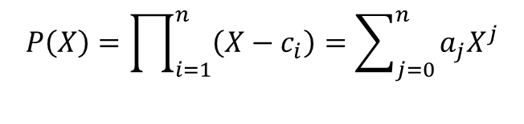

Private Set Intersection
Client
Server
Public key: K
Secret key: K’
Public key: K
$$C=\{c_{1},…, c_{n}\}$$
$$S=\{s_{1},…, s_{m}\}$$
$$P\left(X\right)=\prod_{i=1}^{n}{\left(X−c_{i}\right)}=\sum_{j=0}^{n}{a_{j}X^{j}}$$
For each s_{j} ϵ S:
Pick a random r_{j}
Homomorphically evaluate P(s_{j})
E_{K}(r_{j} P(s_{j}) + s_{j})
$$E_{K}\left(a_{0}\right), ⋯,E_{K}\left(a_{n}\right)$$
$$E_{K}\left(r_{1}P\left(s_{1}\right)+s_{1}\right), ⋯,E_{K}\left(r_{m}P\left(s_{m}\right)+s_{m}\right)$$
If c_{i} = s_{j}, then E_{K} (r_{j} P(s_{j}) + s_{j}) = E_{K} (s_{j})
Otherwise E_{K} (r_{j} P(s_{j}) + s_{j}) = E_{K} (r), for some random r
Notes:
How to modify this scheme such that we only get the cardinality of the intersection?
Compute E(r_{j} P(s_{j})) instead of E(r_{j} P(s_{j}) + s_{j}), the number of encryptions of ‘0’ is the cardinality of the intersection.
See Paillier for an additive homomorphic scheme that can be used here: Paillier, Pascal. "Public-key cryptosystems based on composite degree residuosity classes." EUROCRYPT '99.

Slide 32
Additive Homomorphic Encryption
Addition
E_{K}(m₁) ◦ E_{K}(m₂) = E_{K}(m₁ + m₂)
Multiplication (by a constant c)
E_{K}(m)^{c} = E_{K}(m) ◦ ... ◦ E_{K}(m) = E_{K}(c ∙ m)
Schemes in practice are IND-CPA secure; i.e., provide randomized encryptions
E_{K}(m) is really E_{K}(m, r), for some random r
Re-randomization: E_{K}(m) ◦ E_{K}(0) = E_{K}(m)
Notes:
Addition refers to the operation in the plaintext space. With AHE we get a multiplication by a constant operation for free.
In practice, we need the cryptosystem to be IND-CPA secure. In particular, this means that they provide nondeterministic (i.e., randomized) encryption; two ciphertexts for the same plaintext will be different with high probability.
Paillier: Paillier, Pascal. "Public-key cryptosystems based on composite degree residuosity classes." EUROCRYPT '99.

Slide 33
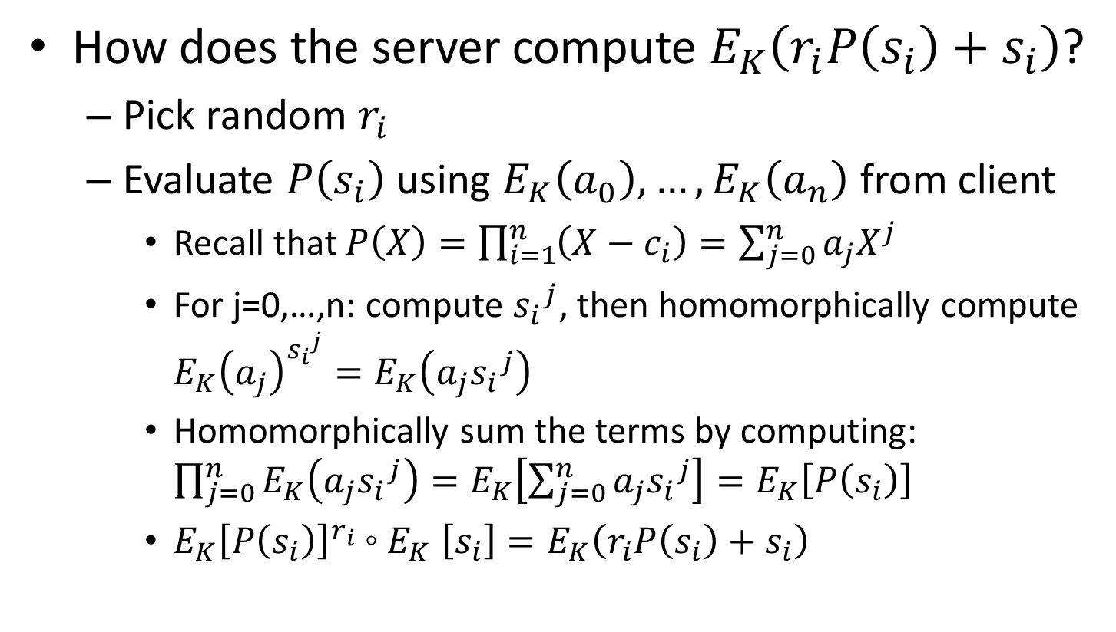
Private Set Intersection
How does the server compute $E_{K}\left(r_{i}P\left(s_{i}\right)+s_{i}\right)$?
Pick random $r_{i}$
Evaluate $P\left(s_{i}\right)$ using $E_{K}\left(a_{0}\right), …,E_{K}\left(a_{n}\right)$ from client
Recall that $P\left(X\right)=\prod_{i=1}^{n}{\left(X−c_{i}\right)}=\sum_{j=0}^{n}{a_{j}X^{j}}$
For j=0,…,n: compute ${s_{i}}^{j}$, then homomorphically compute ${E_{K}\left(a_{j}\right)}^{{s_{i}}^{j}}=E_{K}\left(a_{j}{s_{i}}^{j}\right)$
Homomorphically sum the terms by computing: $\prod_{j=0}^{n}{E_{K}\left(a_{j}{s_{i}}^{j}\right)}=E_{K}\left[\sum_{j=0}^{n}{a_{j}{s_{i}}^{j}}\right]=E_{K}\left[P\left(s_{i}\right)\right]$
${E_{K}\left[P\left(s_{i}\right)\right]}^{r_{i}}{\text{◦} E}_{K}\left[s_{i}\right]=E_{K}\left(r_{i}P\left(s_{i}\right)+s_{i}\right)$

Slide 35
References
[RAD78] Rivest, Adleman, and Dertouzos. "On data banks and privacy homomorphisms." Foundations of secure computation 4.11 (1978).
[CGPR15] Cash, D., Grubbs, P., Perry, J. and Ristenpart, T. “Leakage-abuse attacks against searchable encryption.” ACM CCS 2015.
[GO96] Goldreich, and Ostrovsky. "Software protection and simulation on oblivious RAMs." Journal of the ACM (JACM) 1996.
[FNP04]: Freedman, Nissim, Pinkas. "Efficient private matching and set intersection." EUROCRYPT 2004.

Slide 36
Discussion Questions
Why not just trust the cloud provider?
Are there alternative architectures for searchable encryption?
Keep the index on the client?
Use two cloud providers?
What other problems could be solved using Private Set Intersection?

